Slide 1
FUEL ECONOMY
INSTITUTION AFFILIATION
STUDENT’S NAME
DATE

Slide 2
Fuel Economy
Factors determining the price of gasoline
Introduction
Gasoline is produced based on the level of octane. The level of octane in gasoline measures its ability to support combustion.
Gasoline with a greater level of octane is not highly disposed to explosion and eruption.
However, refiners charge high for the fuel resulting from octane, which is the main component that products gasoline while at the same time, quality grade gasoline is the most costly.
For instance, from the year 1995 to the year 2006, the difference in price between the different grades of gasoline was frequently around 10¢ per gallon. There was a general increase in prices of gasoline right away from the year 2006.
Currently, the yearly average of the cost per gallon of media grade gasoline was around 34¢, which was more than the value of the typical gas. However, the main factors that determine the price of gasoline are the cost of crude oil, refining costs, and profits, distribution and marketing costs and benefits and taxes.

Slide 3
The cost of crude oil
The general price of crude oil is the main elements that determine the price of gasoline.
The amount of crude oil which also contributes by assessing the price of gas, changes based on time, and across the different parts of the country.
According to Leas et al. (2018), many factors affect the price of crude oil, which also affects the general cost of gasoline.
They include; the general market elements and other factors that are associated with trading and financial markets.
Generally, the rise of the production cost of oil in the United States in the previous years has assisted in reducing the burden subjected to the prices of gasoline.

Slide 4
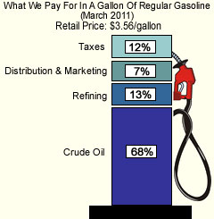
Factor determining the price of gasoline
https://www.dummies.com/wpcontent/uploads/274104.image0.jpg

Slide 5
Taxes
The government of the country also contributes more on determining the general prices of the gasoline. For instance, the local administration policies on taxes provide either by increasing or reducing the gasoline prices.
For example, the state gasoline cut out tax can be18.30¢ per gallon. This is because many funds are set aside to repair the roads because most of the gas is transported using ways.
This can either be a favor or discouragement to the citizens depending on the state of the economy. On July 1 last year, the aggregate tax imposed by the state on gasoline per gallon was around 28.62¢.
Generally, taxes on sales as well as taxes imposed by the local and state administration can have an essential influence on the price of gasoline in different parts of the world (Leas et al. 2018).

Slide 6
Supply and Marketing Cost
The cost incurred on the transportation of finished product like gasoline from the main points of production or refining point to the main supply points also determines the price the gas across the country.
This includes transporting gasoline using trucks from racks to market outlets like the gasoline station and convenience stores as well as and distributing the gas to the consumers in the market.
The conventional method used in the transportation of gasoline is ships, truck, pipelines, and railcars, which are very expensive to construct and maintain them, therefore, leading to the increase in the price of the gasoline.

Slide 7
Cont..
Also, there are other external costs, like labor and utilities. However, all these factors contribute to the general increase in the price of gas in the market.
Amarfio, (2017) proposed that autonomous businessmen, especially those who buy gas from refiners and other wholesalers for resale to the general consumers.
The difference of the prices from the movement from different points shows a precise local market circumstance and aspects, such as the fueling location and the marketing approach of the owner have an overall impact to the prize of the gasoline.

Slide 8
The cost of refining gasoline
Converting crude oil into gas needs to undergo a refining process.
However, the cost of refining changes concerning the specification of the intended final product and the condiments that are used to boost it.
For instance, gasoline produced during summer usually has a low rate of vaporization that is needed to remove excess air pollution.
This imposes an extra cost that makes gas to have varying price charge.

Slide 9
Cont.…
Additionally, gasoline is sometimes prepared at different power and performance levels of octanes like the 87, 89, and 93, therefore, the greater the octane, the higher the manufacturing cost of gasoline making it have price difference.
Gas has an additional cleansing agent that wash engines and improve their performance.
These other requirements and activities also increase the cost. Cost to refine gasoline varies between $.40 and $.70 per gallon, subjected to either summer or winter season being used (Leas et al. 2018).

Slide 10
Location
The location of either the gasoline production site or the supply point affects the price of the gasoline.
The expenses of taking the business by individual gasoline wholesalers vary critically depending on whether the gasoline fueling station is located near or far.
Generally, it involves some costs like wages and salaries, welfares, tools, lease and rent payments, insurance, overhead cost, and local fees. Also, retail stations that are very close to each other can have unique traffic arrangements, rent, and sources of supply that influence the price of gasoline.
In simple terms, the location and number of competitors also impact the prices of gas because they can set different price tags on their products.

Slide 11
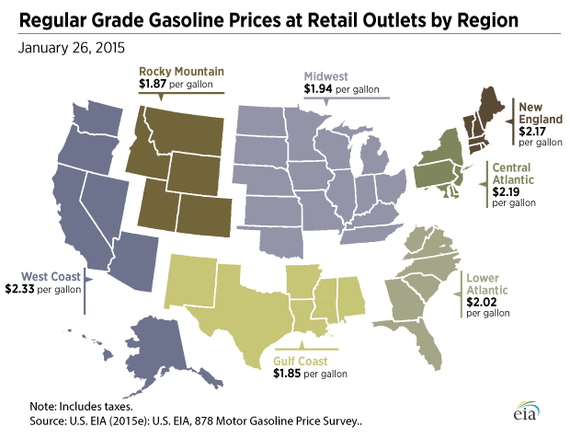
How location Affects the price of gasoline
https://www.stlouisfed.org/~/media/Publications/Inside-the-Vault/Spring-2015/GasPricesRegion.gif?la=en

Slide 12
Geopolitics
Amarfio (2017) also urged that the geopolitical landscape impacting the prize of gasoline has moved intensely from the year 2009 to the year 2013.
The United States is among the world’s major producers of the natural gas and petroleum hydrocarbons, which is directly reflecting the production of Russia and Saudi Arabia.
Several companies are accountable for the popularity of United States production of oil, and each one is coming up with their own distinct choices concerning output and investment.

Slide 13
Cont.…
These corporations are competing at a higher rate, and the U.S. firms in the oil industry are not working together to attain a geopolitical target, which is contrary to the producers.
The attempt by United States companies to control market prices be economically counterproductive would establish a violation of antitrust laws that affects the prices of gasoline.
The markets remain to dangle on any term from the Iranian command or any other country that is based on gasoline production; therefore, this can cause gasoline prices to go wild.

Slide 14
Commodities market presentation
Another factor that causes price changes of the gasoline is the price speculation of the goods market, especially on materials that are used to produce gas like the crude oil.
However, they make the prizes either to increase or decrease (Penfold, 2019). In the case where the price of the raw materials or gasoline finished product will hike, then prices are likely to increase because people will make more purchases and save for future use.
Contrary to the other situation when prices are anticipated to be low where people will keep and wait until the real-time to reach so that they can purchase at a lower price. Many sellers and retailers mostly practice these anticipations.

Slide 15
Disruptions of the supply network
Intermissions in the movement of crude oil over the supply network can cause the prizes of gasoline to raise or reduce.
In most cases, the interruptions are natural disasters such as the Hurricane Katrina, the Gulf Coast-BP oil spill, and also political uncertainty in producing countries such as Iraq, Libya, Yemen, Saudi Arabia, Venezuela, and Nigeria in America.
Where interruptions are not there, and there is a smooth supply of the gasoline, there is no high impact on the prizes as when compared when the disruptions are present (Penfold, (2019).

Slide 16
Conclusion
The above factors discussed above have a significant impact on the general prices of gasoline.
Therefore, emphasis needs to be placed ahead, especially by the producing countries and also other countries to ensure that there is fare prize charge of the gas that is affordable by the people.
State government should also work in hand to ensure that economic conditions are well structured that favor gasoline consumption like the elimination of tax or reducing taxes.

Slide 17
Bibliography
Laes, E., Mayeres, I., Renders, N., Valkering, P., & Verbeke, S. (2018). How do policies help to increase the uptake of carbon reduction measures in the EU residential sector? Evidence from recent studies. Renewable and Sustainable Energy Reviews, 94, 234-250.
Amarfio, E. M. (2017). Determining the Global Pricing of Crude Oil Using Trend Analysis and Numerical Modelling. Ghana Journal of Technology, 2(1), 82-90.
Penfold, S. (2019). Cyril Shelford, Gasoline, and the Politics of Free Enterprise in Postwar British Columbia. Canadian Historical Review, 100(2), 137-159.

